Slide 1

"I looked at my competitors and I thought that, If they could do it, I could do it. And if, they are popular and doing well, I could compete with them."
Tommy Hilfiger

Slide 2

How to do a basic market analysis

Slide 3

How to do a more sophisticated market analysis?

Slide 4
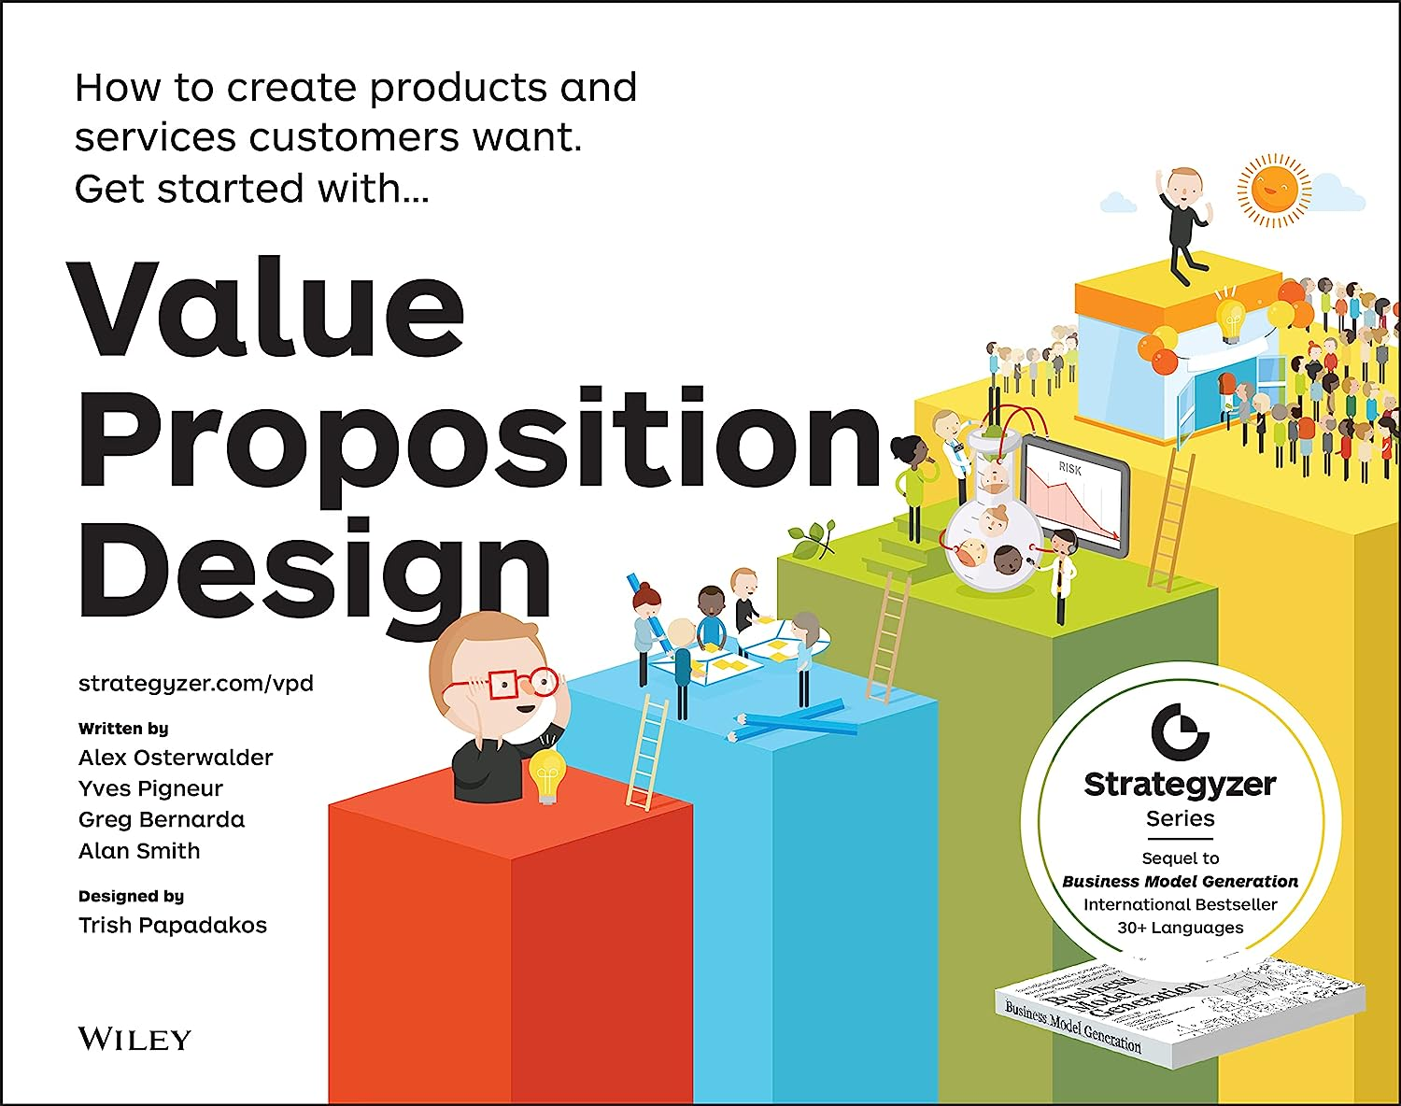
Start at the beginning
What is your value proposition?
Write a 1-3 sentence value proposition.

Slide 5

The Customer Story
How does a customer/client/user interact with your idea?
Write a step-by-step story of how one customer/client/user engages and receives benefit.

Slide 6

Market Opportunity
Who are the early adopters?
Who are in the target market?
How big is the demographic?
What is the projected growth?

Slide 7

Competitive Advantage
What do potential customers do now to solve this problem?
Who is your competition?
What does your solution provide over the competition?

Slide 8
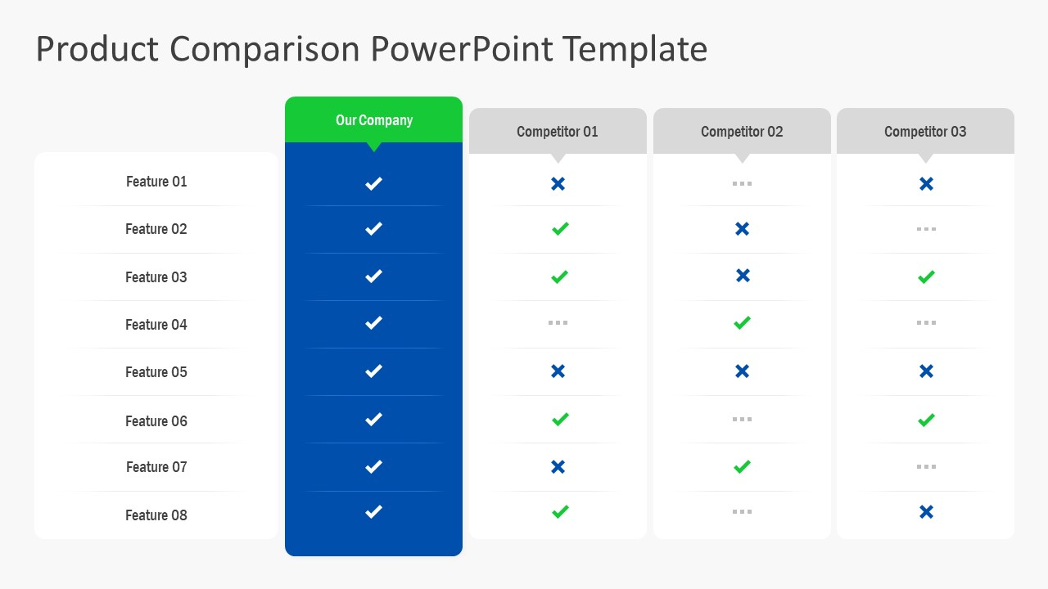

Slide 9


